Slide 1
Prediction of excitable wave dynamics using machine learning
Journal Club
Will An

Slide 2
Introduction
It predicted both spatial and temporal information of spiral waves.
It used a Deep-Learning Encoder-Decoder Model.
It predicted the next frame solely based on current frame with membrane voltage channel.
It had very good prediction results within O(100) ms.
It worked for both quasiperiodic (QP) and spiral defect chaos (SDC) cases.

Slide 3
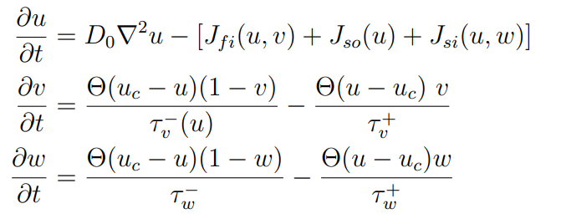
Data
They used Fenton-Karma Model (3V SIM Model) for trains and predictions.
50 QP simulations train
50 random ones train
500 SDC simulations
450 remaining test
Each simulation 400 successive snapshots 10ms apart

Slide 4
Data
Instead of using all three state variables, they only used membrane potential u
And thus solely one frame to predict next frame 10ms apart

Slide 5
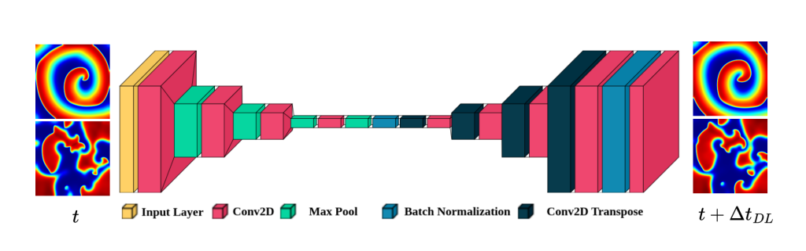
Model

Slide 6
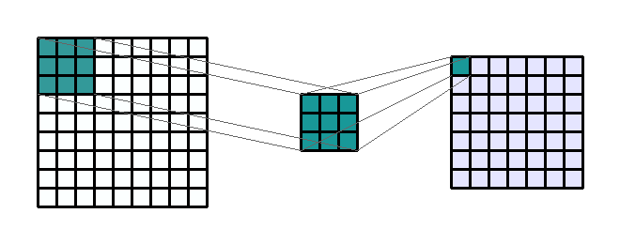
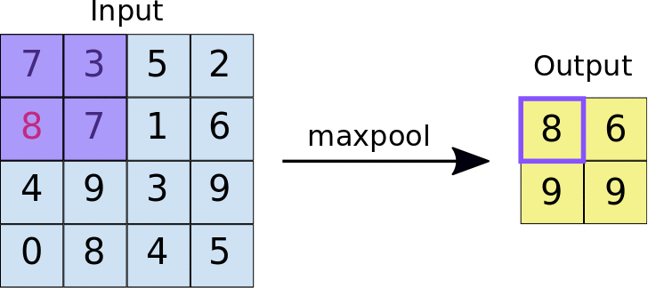
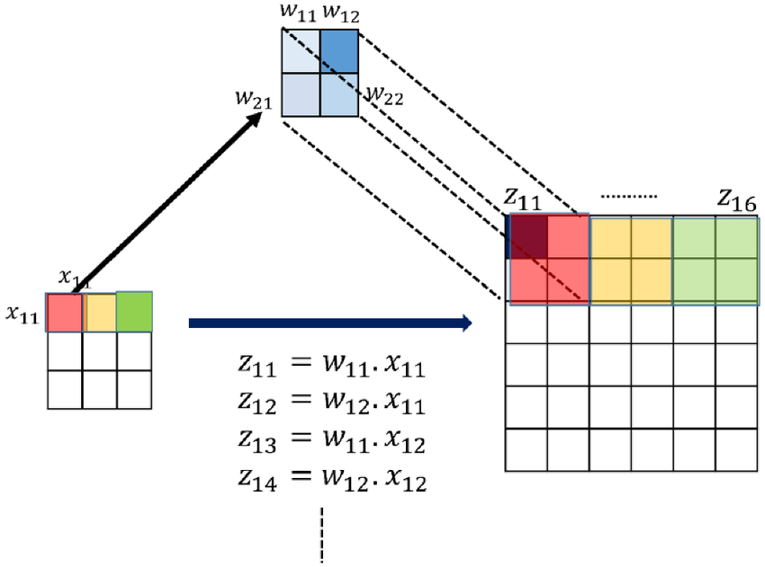
Model
Conv2D:
MaxPool:
Batch Norm: normalize the u value
Conv2D Tranpose: reversed Conv2D

Slide 7
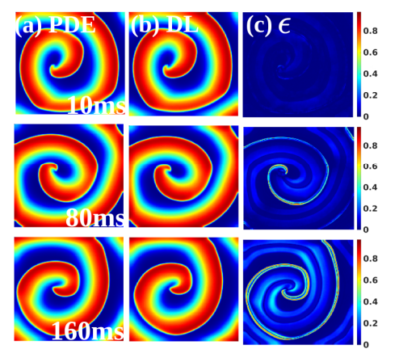
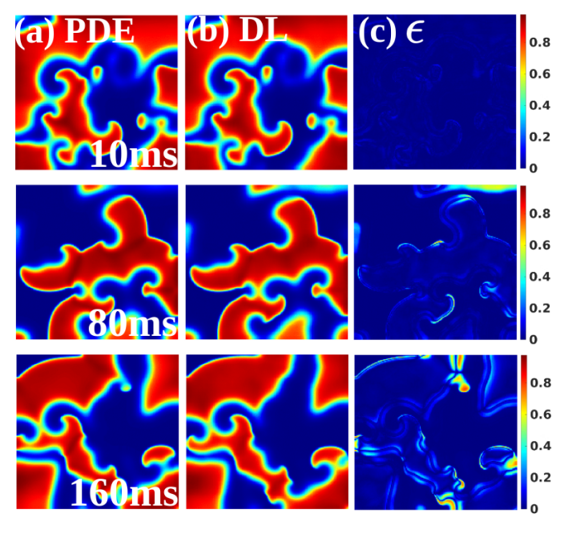
Result – QP and SDC

Slide 8
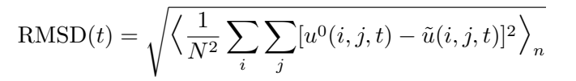
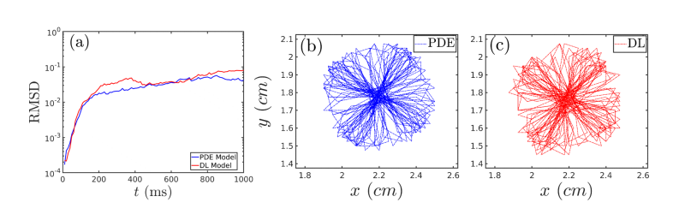
Result – Compared with perturbed PDE
Random noise was added uniformly between 0 and 1 and with amplitude 1e-5, to u at each pixel. (in QP cases)

Slide 9
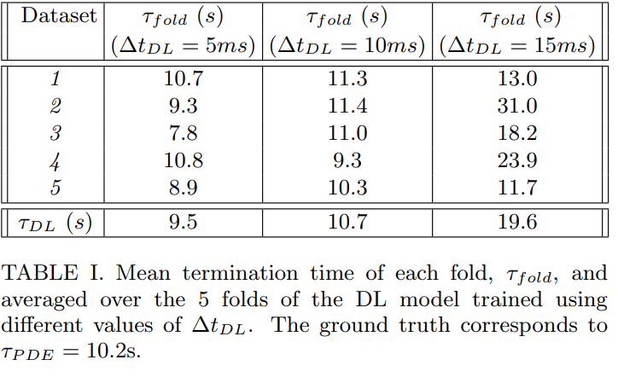
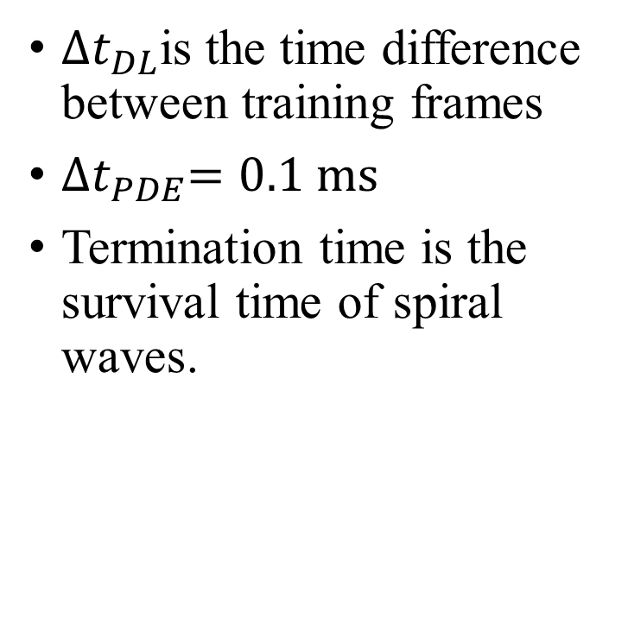
Result – Termination time
${∆t}_{DL}$is the time difference between training frames
${∆t}_{PDE}=0.1 ms$
Termination time is the survival time of spiral waves.

Slide 10
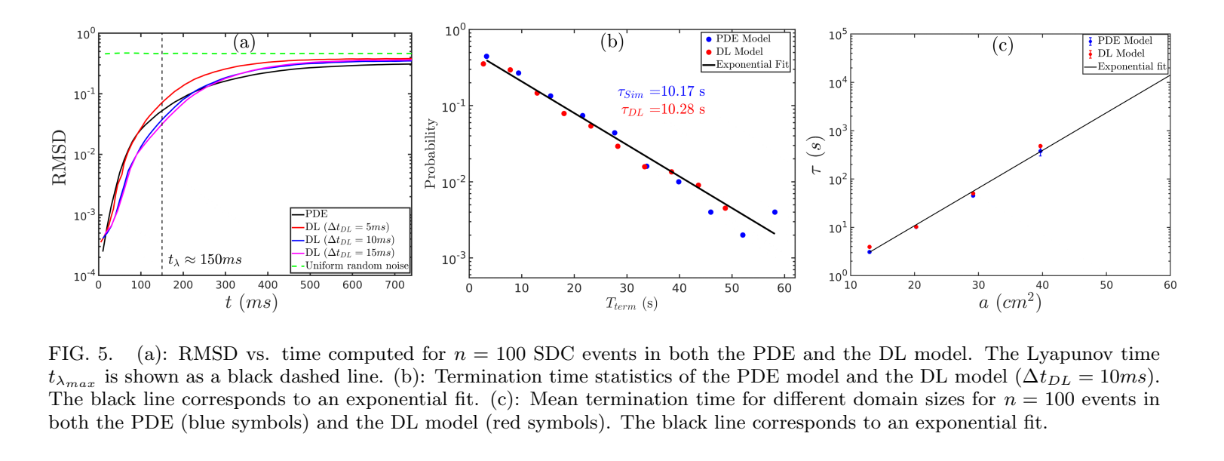
Result – Accuracy test

Slide 11
Conclusion
It shows that Deep learning conv2d model could predict both QP and SDC in 2D map, with only initial frame given.
The ML prediction has a similar error rate with PDE under small perturbation.
It also successfully predicts the termination time of spirals and its exponential law with domain size.

Slide 12
Thanks!

